Slide 1
Rapid app prototyping with shorter development cycles
by Baruch Berger

Slide 2
Development cycles?
Time it takes for the developer to:
Write code -> See change happen ->
Adjust code -> See change happen
repeat..

Slide 3
Front-end web development cycle
Normally:
Write code. (html/css/javascript) -> Save files. -> [optionally compile assets with webpack/browserify/gulp/grunt] -> Manually refresh browser. -> See change.
A little faster (livereload):
Write code. (html/css/javascript) -> Save files. -> [optionally compile assets with webpack/browserify/gulp/grunt] -> Automatically refresh browser. -> See change.

Slide 4
Front-end web development cycle
Even faster (hot code swap):
Write code. (html/css/javascript) -> Save files. -> [optionally compile assets with webpack/browserify/gulp/grunt] -> Automatically send changed data and functions to browser -> See change.

Slide 5
Using hot code swap is not easy (but worth it!)
It requires:
Using certain technologies (browserify/webpack/figwheel(ClojureScript)).
Thinking about how to manage the state of your app.
Making sure your change is visible.

Slide 6
Demo technologies
React/d3/immutable.js
React for components
d3 for graphics stuff
immutable for:
no defensive copying
easy undo
easy working with nested data / collections
React-hot-loader
Detects and swaps code changes where possible
Redux
Helps with: Thinking about how to manage the state of your app.
Helps with: Making sure your change is visible.

Slide 7
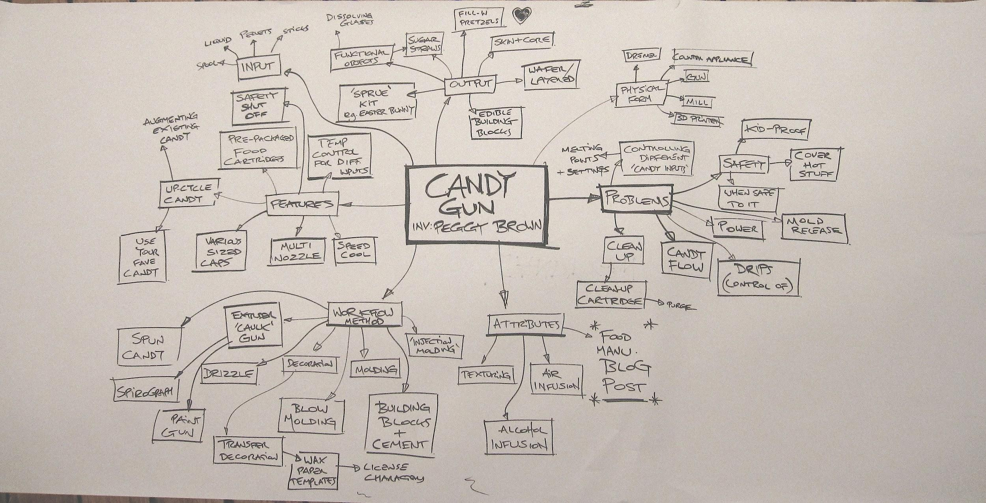
Demo idea
Brainstorm app
visualize relations between concepts
add concepts
remove concepts
rename concepts
move concepts
merge concepts

Slide 8
Getting started
"git clone https://github.com/gaearon/react-hot-boilerplate",
"copy contents of the react-hot-boilerplate folder to your project",
"npm install -g webpack",
"npm install --save redux",
"npm install --save react-redux",
"npm install --save-dev redux-devtools",
"npm install immutable --save",
"npm install d3 --save",
"npm start and open browser to go to localhost:3000"
branch one

Slide 9
Hello world
We have a working web page
That can be hot reloaded!
But not much else..
branch one

Slide 10
Adding Redux and React
We want to use Redux to use “actions” to change the application state data.
The actions are used by a reducer (sounds scary/complex, but is quite simple!)
The actions are sent to reducers by a dispatcher that Redux already has for us.
And the app state data is then shown with a React component

Slide 11
Redux flow (¼) -think of an action-
We create an action. The action is a simple JS object -->
let anAction = { type: "Something happened!", payload: "I said hello"}

Slide 12
Redux flow (2/4) -dispatch the action-
The action is “dispatched” by a dispatch function
import { createStore } from 'redux';
let store = createStore(() => {});
store.dispatch(anAction)

Slide 13
Redux flow (¾ ) -change app state-
The action is used by a reducer function that we write ourselves.
We change the app state in the reducer function
function exampleReducer (initialState = {}, action = {}) {
switch (action.type) {
case 'Something happened!':
console.log(action.payload)
return initialState.something = action.payload
default:
return initialState
}
}
let store = createStore(exampleReducer);
store.dispatch(anAction)
branch two

Slide 14
Redux flow (4/4) -use state from store-
And use the new app state (like in a react component or d3 view)
in index.js
import React from 'react'
import App from './App'
import { exampleReducer } from './App'
import { Provider } from 'react-redux'
import { createStore } from 'redux'
let store = createStore(exampleReducer)
exports.store = store
React.render(
<Provider store={store}>
{() => <App />}
</Provider>,
document.getElementById('root'))
in app.js
@connect((state) => ({ state: state}))
export default class App extends Component {
render() {
const { state } = this.props
return (
<div>
{state}
Hello world!
</div>
)
}
}
export function exampleReducer (initialState = {}, action = {}) {
switch (action.type) {
case 'Something happened!':
console.log(action.payload)
return initialState.something = action.payload
default:
return initialState
}
}

Slide 15
Most simple application state
Lets focus on most simple application state for a brainstorm app:
let initialGraphState = {
'color': { 'red': {} }
}
A brainstorm about color and a relation of the concept red.

Slide 16
Keeping focus on data
I like to keep my focus on the application state data, so let us focus on two “types” of data:
Data that app currently contains (appState)
Data that we want the app to actually have! (whatWeWant)
We want to add blue!
let initialGraphState = {
color: {
red: {}
}
}
let whatWeWant = {
color: {
red: {},
blue: {}
}
}

Slide 17
The addConcept action
let addBlueAction = {
type: 'addConcept',
payload: {to: 'color', add: 'blue'}
}
store ? store.dispatch(addBlueAction) : null
export function graphReducer (state = initialGraphState, action = {}) {
switch (action.type) {
case 'addConcept':
state[action.payload.to][action.payload.add] = {}
return state
default:
return state
}
}
branch five

Slide 18
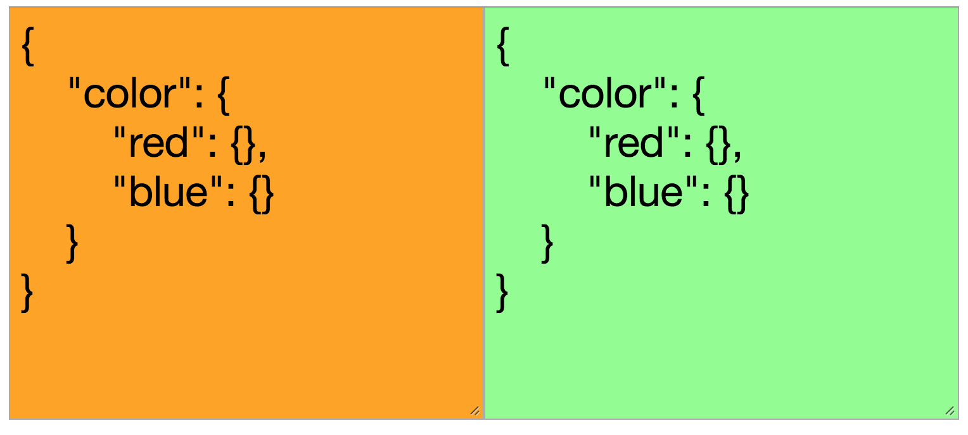
immutable
Comparing to simple json structures with === seems to not work
However Immutable objects can be easily deeply compared.
branch six

Slide 19
The moveAndRenameConcept (merge) action
case 'moveAndRenameConcept':
let movedAndRenamedConcept = state.getIn(action.payload.add)
state = state.deleteIn(action.payload.add)
return state.mergeIn(action.payload.to, movedAndRenamedConcept)
More complex action:
let initialGraphState = immutable.fromJS({
color: {
orange: {
roses: {}
},
red: {}
}
})
let whatWeWant = immutable.fromJS({
color: {
red: {
roses: {}
}
}
})

Slide 20
Skipping boring parts
I will skip the removing and moving actions
Skip all the code required for d3

Slide 21
Making it more visual!
Added a force directed graph to visualize the words in bubbles
transformed the graphState with a function “transformToNodesAndLinks”
@connect((state) => ({
nodesAndLinks : transformToNodesAndLinks(state.get('graph'))
}))
branch: master

Slide 22
Out of time
Sadly I ran out of time to do more on it, I would like to add:
Textfields for adding concepts
Selection on the bubbles for renaming/merging/adding

Slide 23
Conclusion
Making an application is a lot easier if you can see the data you are manipulating change quickly.
Not just easier, a lot more fun too!
Questions?

